Slide 1
Phonics Workshop
8.10.19

Slide 2
In school, we follow the Letters and Sounds programme. Letters and Sounds is a phonics resource published by the Department for Education and Skills which consists of six phases.

Slide 3
Phase 1
There are 7 aspects with 3 strands.
A1 – Environmental
A2 – Instrumental sounds
A3 – Body Percussion
A4 – Rhythm and rhyme
A5 – Alliteration
A6 – Voice sounds
A7 – Oral blending and segmenting.

Slide 4
Phase 2
Set 1: s, a, t, p
Set 2: i, n, m, d
Set 3: g, o, c, k
Set 4: ck, e, u, r
Set 5: h, b, f, ff, l, ll, ss

Slide 5
Throughout phase 2:
We work on initial, middle and end sounds in the words. – finding objects with certain sounds.
We consistently work on oral blending throughout phase 2. – Robot talk.
We introduce reading CVC words when we feel the children are ready. – Word cards/CVC matching games.
We teach the children the tricky words.
Spellings will be given when we feel your child is ready.

Slide 6
Blending
Building words from phonemes to read.
c a t
cat

Slide 7
Segmenting
Breaking down words for spelling.
cat
c a t

Slide 8
Phase 3
Set 6: j, v, w, x
Set 7: y, z, zz, qu
Consonant digraphs: ch, sh, th, ng
Vowel digraphs: ai, ee, igh, oa, oo, ar, or, ur, ow, oi, ear, air, ure, er

Slide 9
Throughout phase 3:
We consistently work on blending and segmenting of words. Bingo, matching games, threading.
We teach the children the tricky words within the phase.

Slide 10
Blending
Qu ee n
queen

Slide 11
Segmenting
Queen
qu ee n

Slide 12
Phase 4
This phase consolidates what the children have learnt in the previous phases, along with teaching them how to read longer words.
We aim for FS children to have finished phase 4 by the end of EYFS.

Slide 13
Phase 5
Children will be taught new graphemes.
Vowel digraphs: wh, ph, ay, ou, ie, ea, oy, ir, ue, aw, ew, oe, au
Split digraphs: a_e, e_e, i_e, o_e, u_e

Slide 14
Throughout phase 5:
We consistently work on blending and segmenting of words. Bingo, matching games, threading.
We teach the children the tricky words within the phase.
Weekly spellings
Children need to be secure in phase 3,4 and 5 to be able to pass the phonic test at the end of year 1.

Slide 15

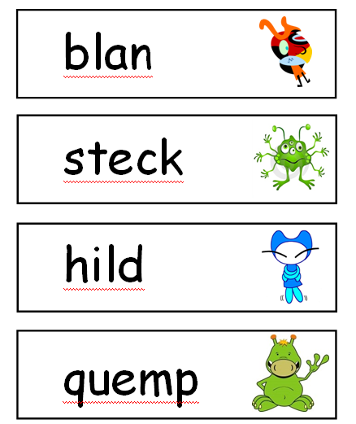
Year 1 Phonics Test – Pass usually 32/40.

Slide 16
Phase 6/Spelling programme
The focus is on learning spelling rules for suffixes.
-s -es -ing -ed
-er -est -y -en
-ful -ly -ment -ness

Slide 17
Tricky words
Within each phase, the children are taught “tricky words.” These are words which we can’t use our phonics to blend.
These words can be found on the hand out.

Slide 18
Phonics is taught daily in EYFS, YR 1 and YR 2. We teach the children in small ability groups. (some year 2 children may have started the spelling programme)
We carry out formal assessments at the end of every half term and move children into groups accordingly.
Reading books will reflect the phase that the child is working on so they can read the text by using their phonics. They can also use contextual clues.
Phonic mats – to revise the phonemes on a daily basis to help reinforce the learning from the class.

Slide 19
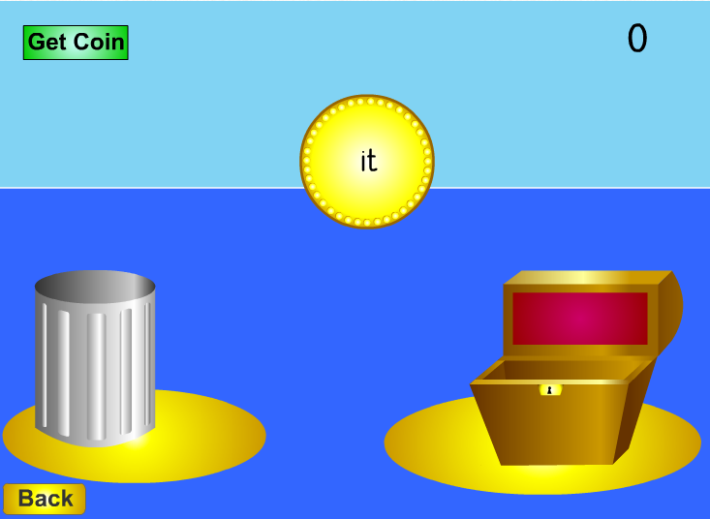
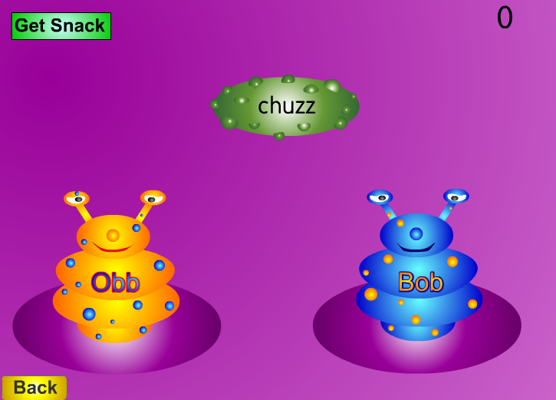
Resources
http://www.phonicsplay.co.uk

Slide 20
Any questions?

